Slide 1


Online Retail Customer Segmentation Analysis
Sub Title: Data-Driven Insights for Business Growth
Presented By : SATHYAVANI K
DATE : 18-03-2025

Slide 2

Introduction
Objective
Identify customer segments and develop targeted strategies to improve customer experience and repeat purchases
Business Challenge
Customer retention and engagement are critical for revenue growth

Slide 3
Data & Methodology
Dataset
Online retail transaction data
Technique
K-Means clustering
Tools Used / Key Variables Considered
Python (pandas, scikit-learn, seaborn, matplotlib)
Recency, Frequency, Monetary Value (RFM Analysis)

Slide 4
Identified Customer Segments
Segment 1 & 2
High-Value Loyal Customers.
Discount-Driven Shoppers
Segment 3 & 4
Occasional Buyers
New Customers

Slide 5

High-Value Loyal Customers
Characteristics
Frequent buyers, high spending per order
Behavior
Strong brand loyalty, low churn
Strategy
Implement loyalty programs, exclusive sales, and VIP services

Slide 6
Discount-Driven Shoppers
Characteristics
Price-sensitive, bulk buying during promotions
Behavior
Responds well to discounts and deals
Strategy
Target with seasonal promotions, flash sales, and coupon campaigns

Slide 7

Occasional Buyers
Characteristics
Moderate spending, infrequent purchases
Behavior
Not highly engaged but has potential
Strategy
Retargeting ads, personalized product recommendations, and email engagement

Slide 8
New Customers
Characteristics
First-time buyers, small purchase amounts
Behavior
Exploring the platform, undecided loyalty
Strategy
Improve onboarding, welcome discounts, and post-purchase follow-ups

Slide 9
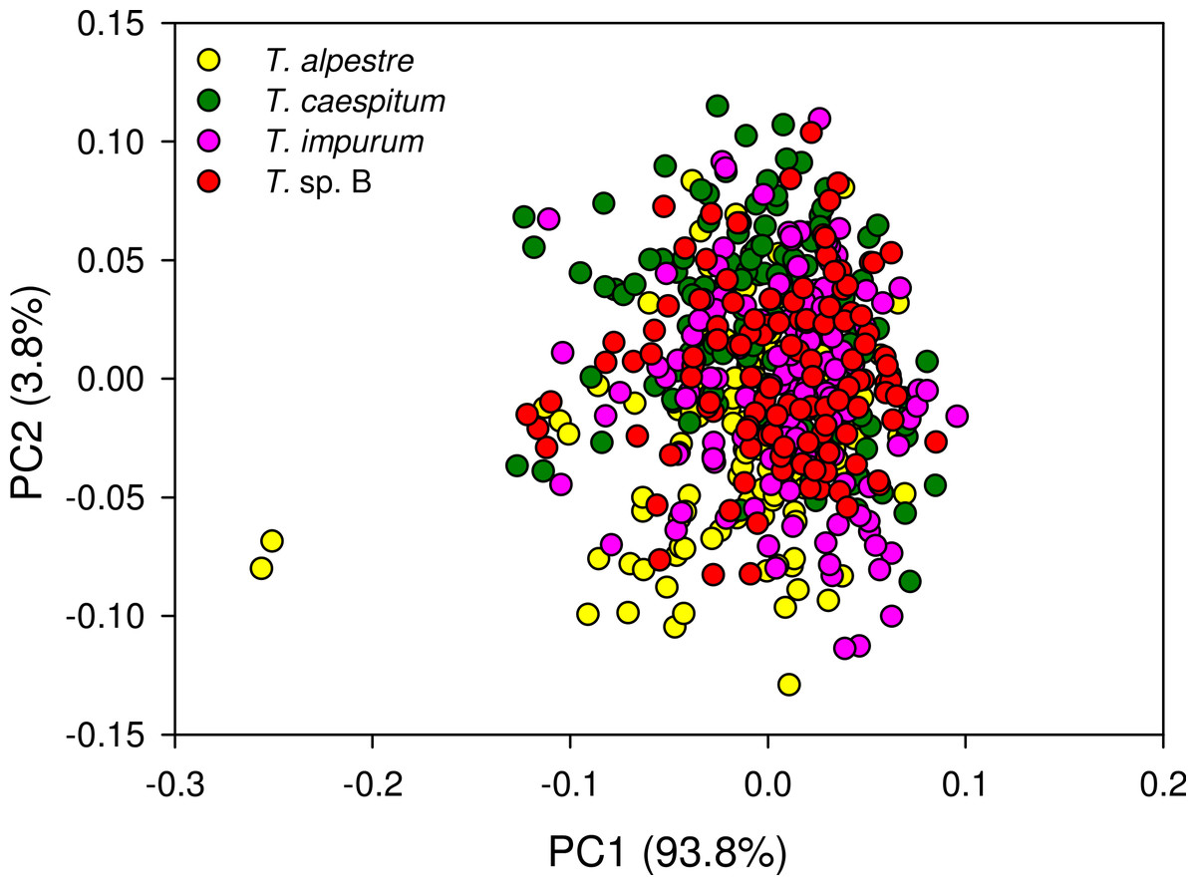
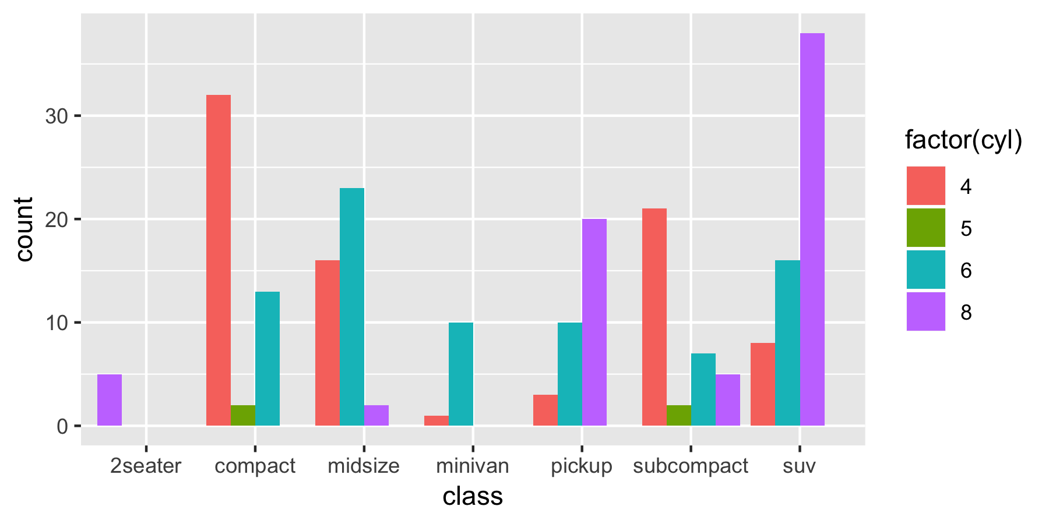
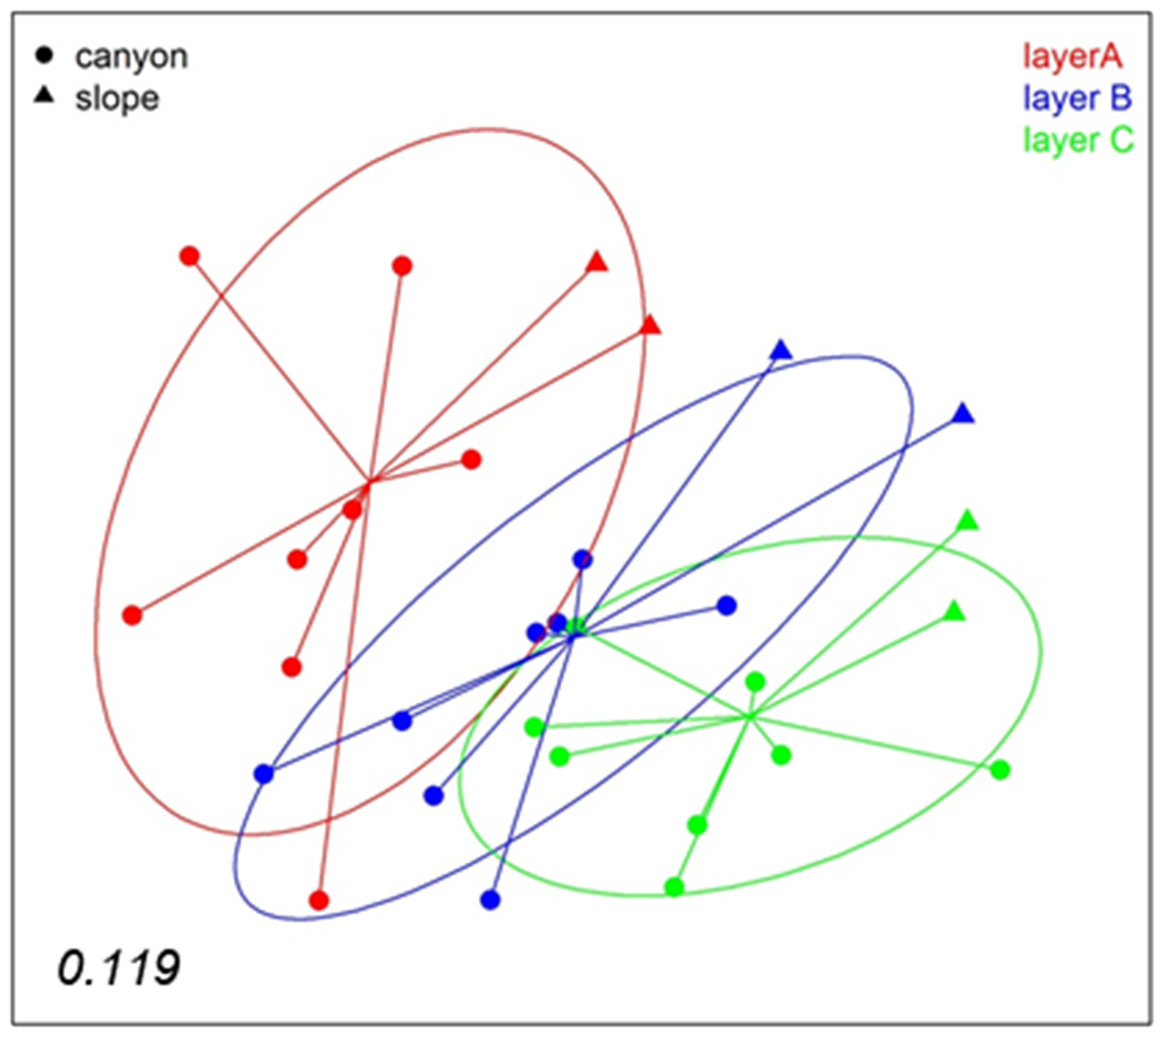
Visualizing Customer Segments
Scatter plots
Show cluster separation
Box plots & bar charts
Compare segment spending behaviour
Centroid analysis
Highlights common traits of each segment

Slide 10
Business Recommendations
Personalization
AI-driven product recommendations and tailored email marketing
Loyalty Programs
Reward repeat purchases for high-value customers
Discount Strategies
Offer exclusive deals to discount-driven shoppers
Re-Engagement Campaigns
Personalized email marketing for occasional buyers
Onboarding Strategies
Enhance the first-time shopping experience for new customers

Slide 11
Summary & Conclusion Data-driven segmentation enables targeted strategies.
Key takeaways
Engage high-value customers with exclusive perks
Optimize promotions for discount-driven shoppers
Implement targeted strategies to boost retention and maximize revenue
Convert occasional buyers into repeat customers

Slide 12
Next Steps
Launch tailored marketing campaigns
Monitor key performance indicators (KPIs)
Refine strategies based on customer response
Drive business growth through data-driven decisions

Slide 13

Thank You!
8884600039
sathyavani.sangeetha@gmail.com
linkedin.com/in/sathyavani-k-1b222a5a
Contact Details & Invitation to Act

